Slide 1
CAPSTORE - Feedbacks common
Hima Priyanka mutyala
Employee id: 190058

Slide 2
Table of Contents
Capstore
Working of Feedbacks common
Code snippet
Output
Software requirements

Slide 3
CAPSTORE
CapStore is a web based e-commerce website that allows users to buy products. Users can view products from different categories and buy them .
Capstore will be a website for Capgemini employees. To buy a product, customer has to select the product and add to his cart, customer can add or remove items in cart at anytime.
In the end an invoice will be generated, The Customer has options of buying product either through CashOnDelivery or through online payments.
Customer has a facility to return the products and can also give a review on them.

Slide 4
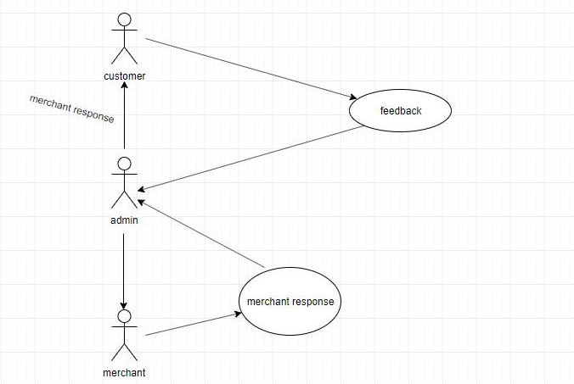
Working of Feedbacks common

Slide 5
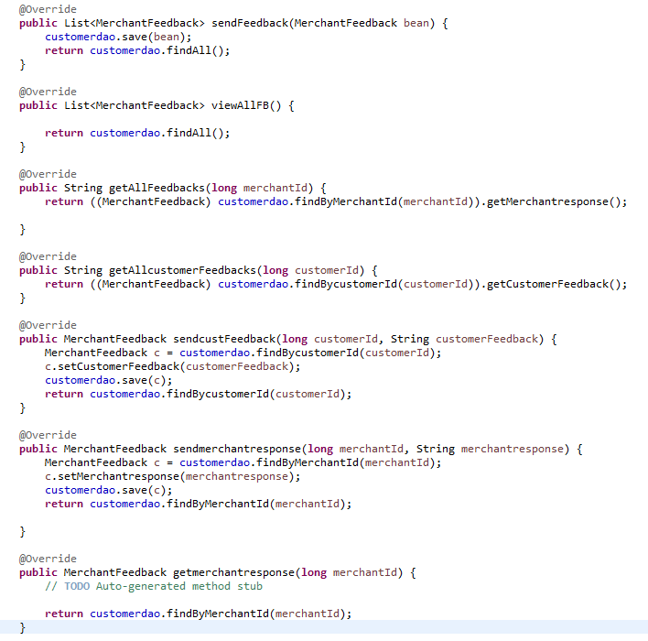
Code snippet

Slide 6
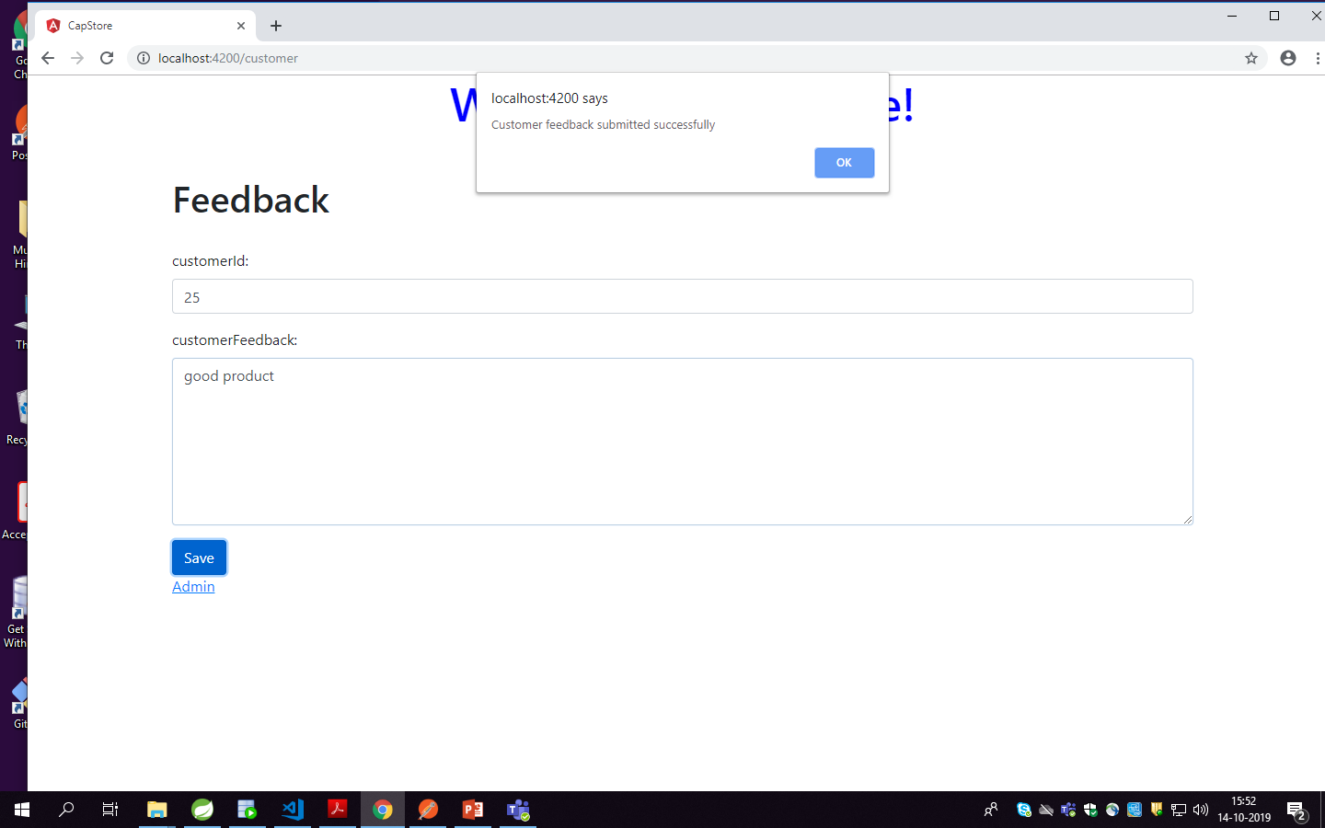
Customer feedback

Slide 7
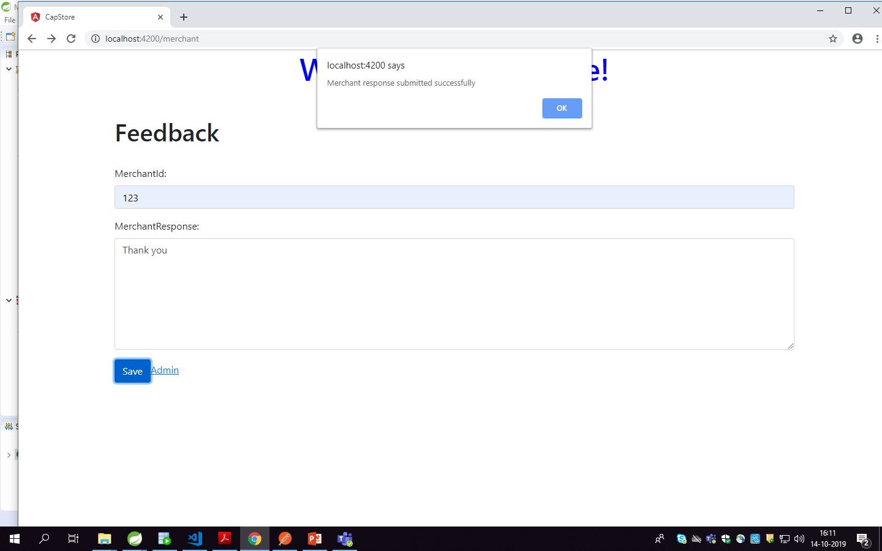
Merchant response

Slide 8
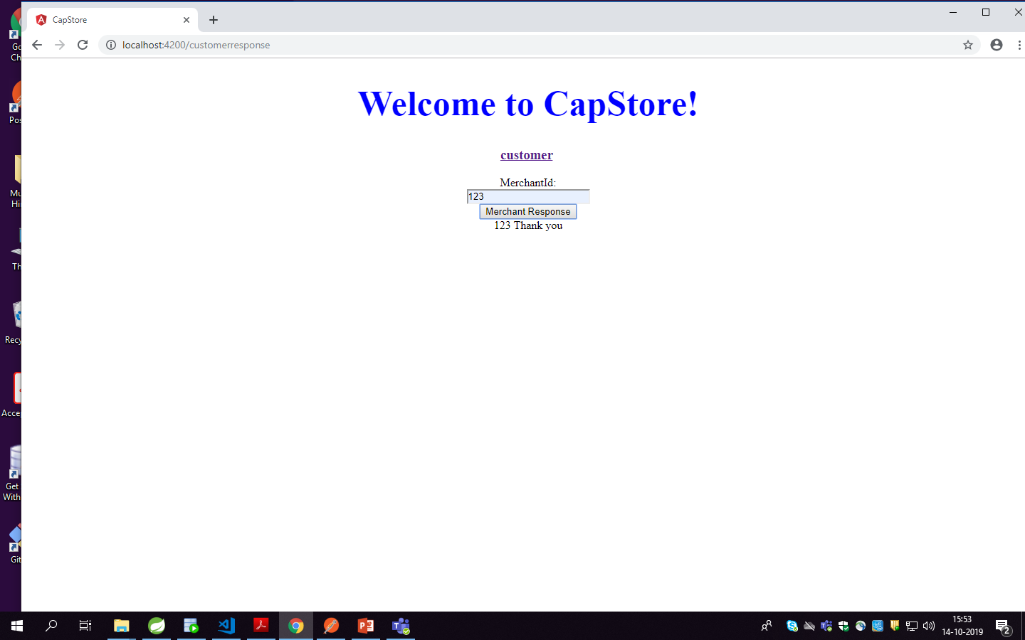
Admin redirecting the responses

Slide 9
Software Requirements
Spring tool suite : Back-end
Visual studio code : Front-end
Oracle SQL developer : Database

Slide 10


